Slide 1

Blue Horseshoe
Jiajie Li Lingzhi Li Zhehao Li Jad Hajali
Daniel Moskowitz
Akshay Vijayendiran
Columbia University November 20, 2019
Carry Trade
Algorithmic Trading

Slide 2
Agenda
Introduction
History of Forex
Overview of Carry Trade
Interest Rate Parity
Leverage in Forex
Risks/Costs
Model Description
Performance/Results
Looking Forward
Conclusion

Slide 3

Daily Volume
$5.1 trillion vs. $84 billion
Players
Investment / Commercial / Central Bank
Multinational Corporate / Hedge Fund / Retail Investor
Centers
London / New York / Tokyo
Zurich / Hong Kong
Notes:
When we talk about trading, most of time we will think about stock. In fact, there exist a huge market, which has a 5.1 trillion trading volume each day. Compare to that, stock market is just like a moon move around the earth. Central bank involved in the game to control inflation rate, Multinational corporate participate in to hedge risk, hedge fund execute strategy to make profit. Rather than stock, this time we will talk about a different thing, the trading of currency
The foreign exchange (also known as FX or forex) market is a global marketplace for exchanging national currencies against one another.

Slide 4
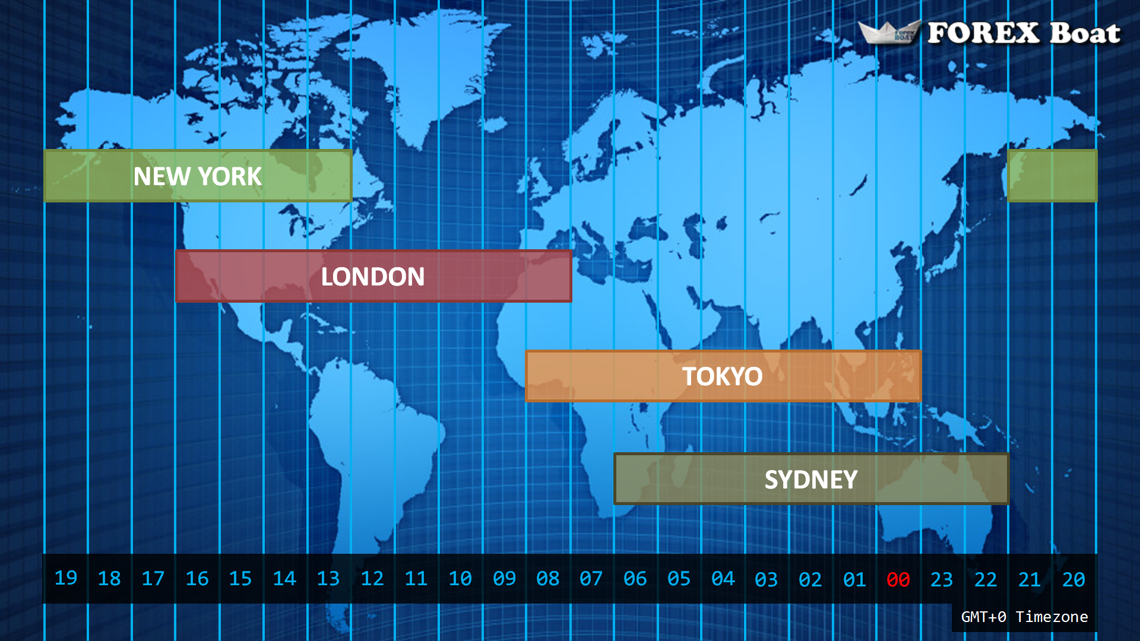
Foreign Exchange Trading
24 Hours a Day UTC
Sydney 22:00-07:00
Tokyo 23:00-08:00
London 7:00-16:00
New York 12:00-21:00
Notes:
Foreign exchange trading is an exciting market. Putting the world into the same time zone, Forex market opens 24 hours every day. Start from sydney at 10 o’clock in the night then, tokyo one hour later, london 12 hours later and end in new york at 9 o’clock in evening. We were attracted by those unique characters and decided to dive deep into the water and explore forex trading strategies.
Speculative currency trades are executed to profit on currency fluctuations can be classified into four main trading sessions mentioned below, The overlap of trading sessions means that there is more trading activity that occurs. Because the market is open 24 hours a day, you can trade at any time of day, which means there's no cut-off time to be able to participate in the market. I believe

Slide 5
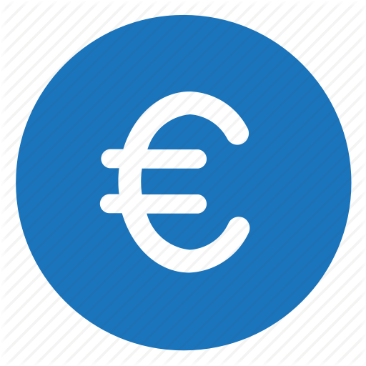



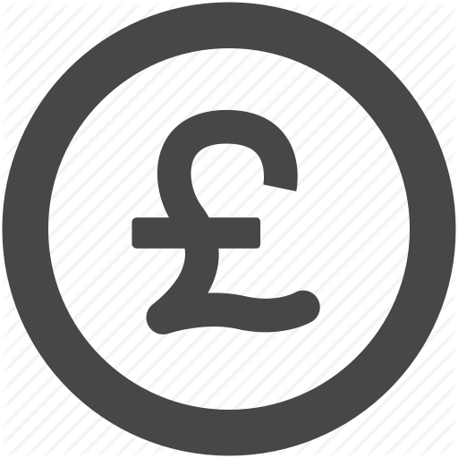
Foreign Exchange Trading
Important Currency Pairs (18 common pairs)
US dollar vs Euro
US dollar vs Japanese Yen
UK pound vs US dollar
Notes:
There are hundreds of currency involved in the trading market. Central as US dollar and connect others such as Euro, Japanese Yen, UK pound and so on. We conducted research on several currency pairs and will discuss our data and model later on. Now, Let us invite Jo to introduce the popular strategy, carry trade to us
The resulting collaboration of the different types of forex traders is a highly liquid, global market that impacts business around the world., the popular currency carry trade strategy highlights how market participants influence exchange rates that, in turn, have spillover effects on the global economy. The carry trade, executed by banks, hedge funds, investment managers and individual investors, is designed to capture differences in yields across currencies by borrowing low-yielding currencies and selling them to purchase high-yielding currencies.

Slide 6
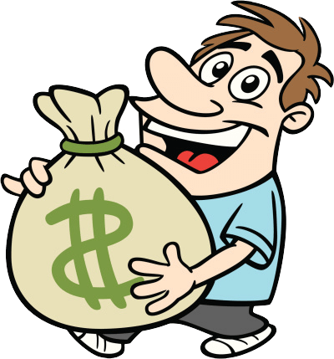
The Carry Trade
Low interest rate currencies (premium) used as funding vehicles
In our case; the Japanese Yen
High interest rate currencies (discount) used to lend
In our case; USD - GBP - AUD
Overview of Carry Trade
Borrow in premium currency
Convert via spot market
Lend in discount currency
Notes:
Our strategy is based on carry trade.
Carry trade is making money with spreads of interests rate in different markets.
We borrow in low interest rate currencies and convert it to high interest rate currencies, then lend it.
In maturity, we can get higher interest return and pay low interest. We earn the spread. Also we may face some risk on the exchange rate.
In our case, we borrow in Japanese yen and convert to Dollar, Australian dollar and pounds.

Slide 7
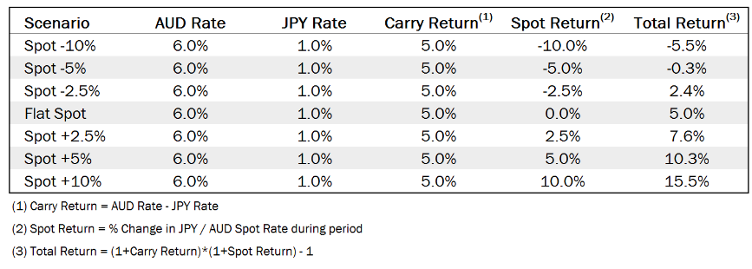
Simple Example
Notes:
This is a simple example of carry trade.
For the flat spot, the exchange rate does not change. Australia dollar’s rate is 6%, Japanese yen’s rate is only 1%. That’s means we can earn 5% by borrowing in yen and lend in Australia dollar.
In the first row, the spot -10% means that JPY may appreciate, AUD may depreciate. This is the exchange rate risk. The lose due to the fluctuation in exchange rate may cause our total return be negative.

Slide 8
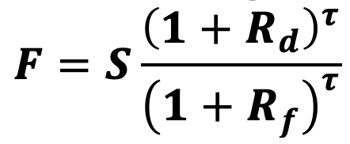
Interest Rate Parity
Interest rate differential is equal to the differential between the forward exchange rate and spot rate
F: forward rate
S: spot rate
Rd and Rf: domestic and foreign interest rates respectively
𝛕: time
No arbitrage argument (Hedging using forward contracts)
The forward outright will trade away from spot by a sufficient amount to encapsulate the spread between the interest rates of the two currencies
Hedging with forwards will get you right back to your domestic interest rate, counting the cost of hedging ⇒ You cannot benefit from interest rate differential without being exposed to currency risk
Notes:
Important concept in FOREX: the market sets the forward outright in relation to spot in order to absorb the interest rate differential between the two currencies.
No Free-Lunch idea: One cannot hop between currencies, picking up yield advantage, and lock up a guaranteed profit by using the forward market to hedge against currency risk.
The forward outright is the spoiler ⇒ No way for investor to capture the yield without taking on risk on future direction of spot exchange rate.
Interest parity works well in normal (efficient) market conditions.
(An outright forward, or currency forward, is a currency contract that locks in the exchange rate and a delivery date beyond the spot value date.)

Slide 9
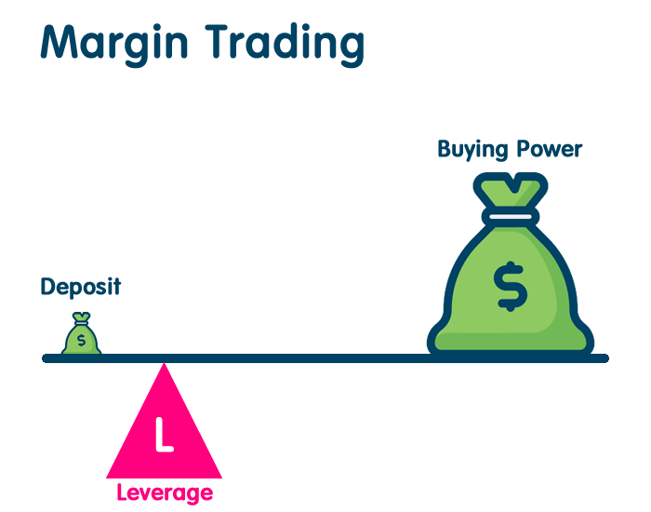
Leverage
The use of debt to increase the trading position
Provided by dealer/broker through margin
Example: trading position of $100,000 using only $1,000 of your own funds
Double-Edged Sword
Amplifies returns
Increases risks
Leverage in FOREX
Leverage ratio could be 100:1 or even more!
Liquid markets
Small changes in pips are amplified by the use of Leverage
Notes:
Forex Leverage is a way for a trader to trade much bigger volumes than he would, using only his own limited amount of trading capital.
Leverage is a double edged sword: amplifies returns but also amplifies losses.
Forex traders often use leverage to profit from relatively small price changes in currency pairs.
Many traders believe the reason that forex market makers offer such high leverage is that leverage is a function of risk. Also, because the spot cash forex markets are so large and liquid, the ability to enter and exit a trade at the desired level is much easier than in other less liquid markets.

Slide 10
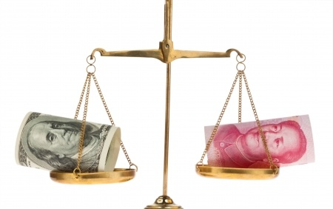
Risks
Foreign Exchange Rate (Currency Risk)
Change in price of one currency against the other
Premium currency could appreciate relative to discount currency
Interest Rate
Interest rate differential could decrease reducing carry return
Other Risks
Leverage
Government interventions
Transaction Costs
Fixed Commission
Variable Spread
Opportunity Cost (Slippage)
Notes:
Exchange rate risk: change in value of one currency relative to other currency could hurt the carry trade
Interest rate risk: changes in interest rates could also hurt the carry trade
As we said before, Leverage increases the risk but also in forex it’s very important to keep track of government interventions
Transaction costs:
Fixed commission of 0.01% on a standard lot trade ($1 for evey $100,000)
Variable spread: We buy at the Ask and sell at the Bid and that is how we calculate the spread cost.
Opportunity cost: related to the timing of trade often called “slippage” is hard to compute but on average we can assume it to be twice the (commision + spread) costs

Slide 11
Model Description: Data
Currency pairs
USD/JPY - GBP/JPY - AUD/JPY
1 week - 1 month - 2 months rebalancing over 12 years
Spot Data easy to find unlike Forward Data
Added Forward points to Spot using Bloomberg Terminal
Bid-Ask Data from Bloomberg Terminal
Managing Data
AUD/JPY 1 week data is missing
AUD Libor was available from 1999 to 2013 only
Used BBSW from 2013 to 2019
No Forward points data for AUD from 2003 to 2007
Used Forward points from 2008 to 2019
Assumed 1 JPY pip to be 0.0001 and then adjusted to 0.01
Holidays / NZD

Slide 12
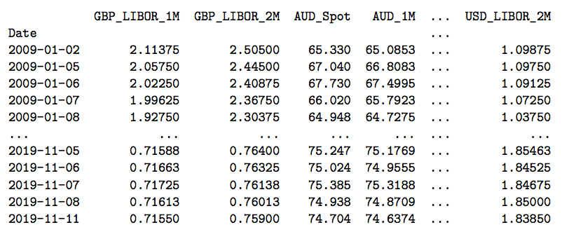
Data Sample (1)

Slide 13
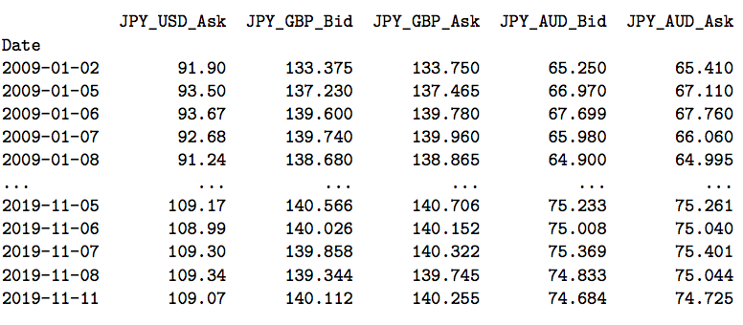
Data Sample (2)

Slide 14
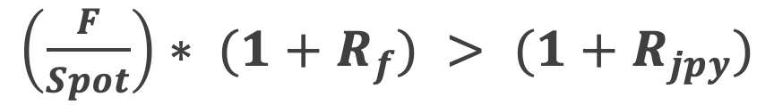
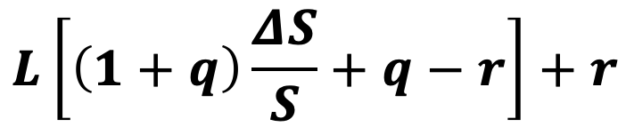

Model Description
If:
Check for currency pair with the Max signal (normalized to time horizon)
If Max Signal > 0 ⇒ implement Carry-Trade
Record the currency pair and time horizon
Return with Leverage = q: foreign rate r: domestic rate,
If Max Signal < 0 ⇒ Stay Flat
If position > 0 and time to get out of position
Get out of position and calculate realized PnL
If position > 0 and NOT time to get out of position
Position unchanged and calculate unrealized PnL
S: spot rate
Notes:
Signal: (F/S)*(1+R_usd) is our return from doing the exchange from JPY and USD
(1+R_jpy) is lending to the JPY

Slide 15
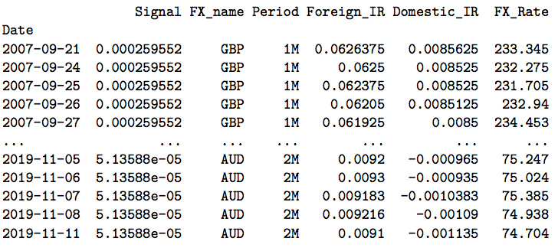
Model Description

Slide 16
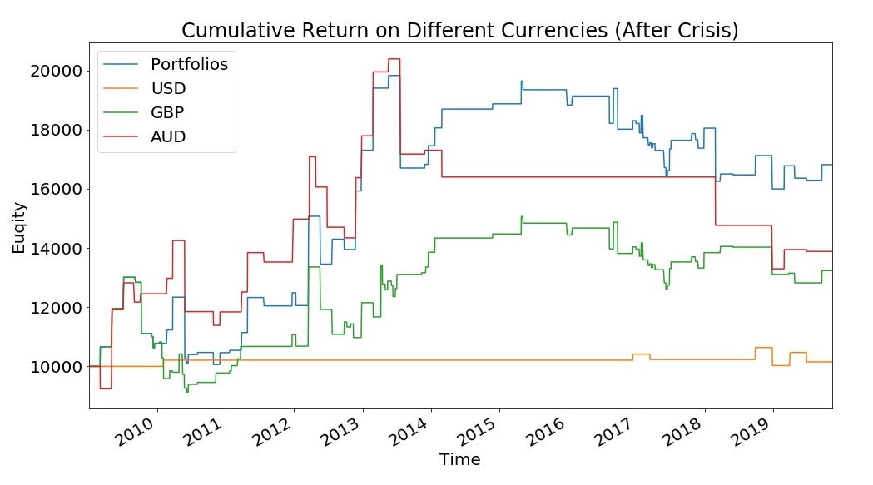
Performance/Results

Slide 17
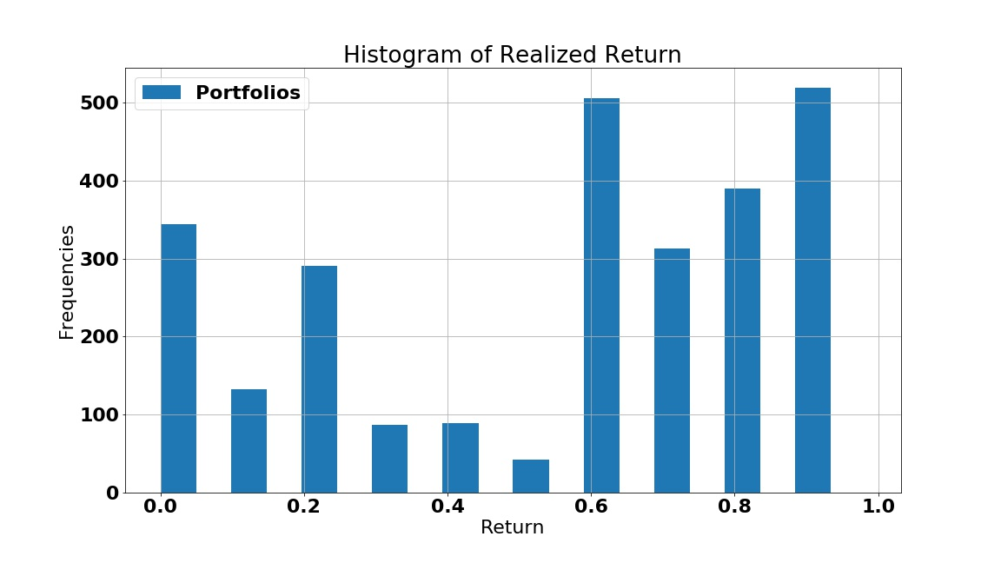
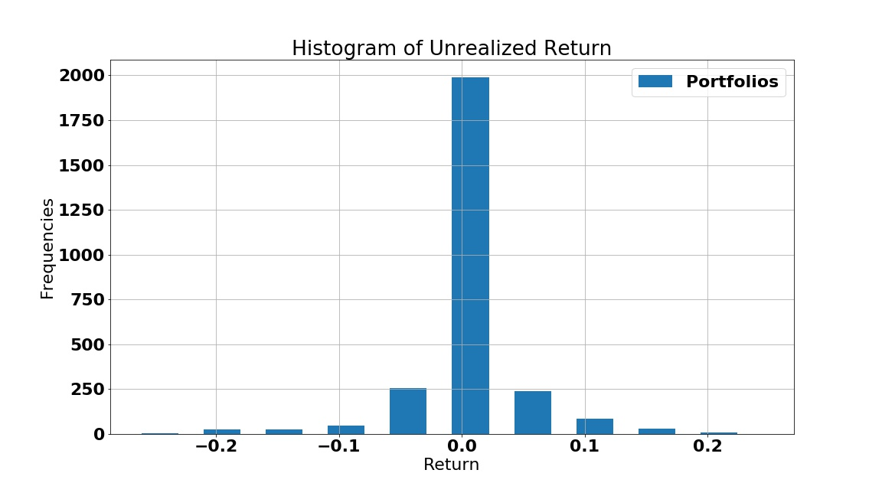
Realized Returns
Unrealized Returns

Slide 18
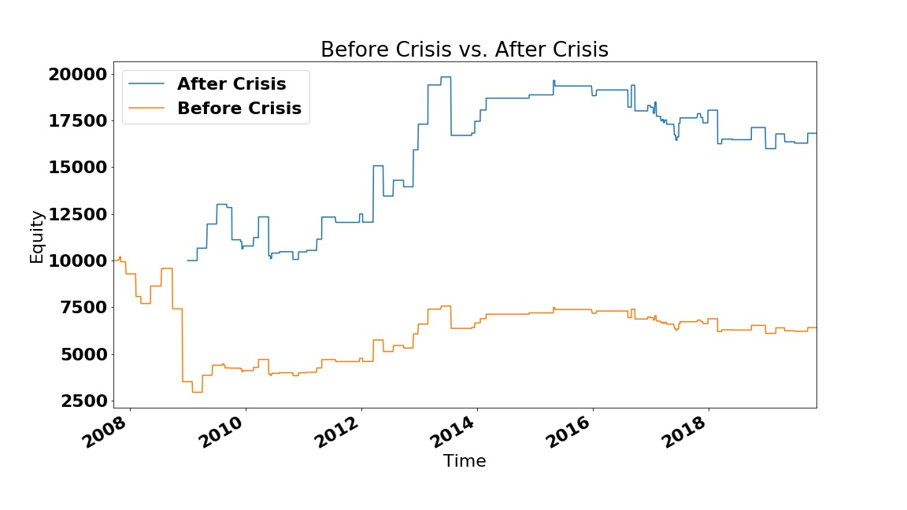
Before Crisis VS. After Crisis

Slide 19
Before Crisis VS. After Crisis
 | After 2007-08 Crisis | Before 2007-08 Crisis
Daily Sharpe Ratio Yearly Sharpe Ratio | 0.158 2.507 | 0.012 0.188
SR with Leverage 2 SR with Leverage 5 SR with Leverage 10 (Yearly) | 2.507 2.488 2.481 | 0.188 0.158 0.148
Value at Risk (VaR) | 90% VaR= 1.7925% 95% VaR= 4.6255% 99% VaR= 16.2635% | 90% VaR= 3.7203% 95% VaR= 9.5685% 99% VaR= 23.5242%
Max Drawdown | 38.3% | 72.5%

Slide 20
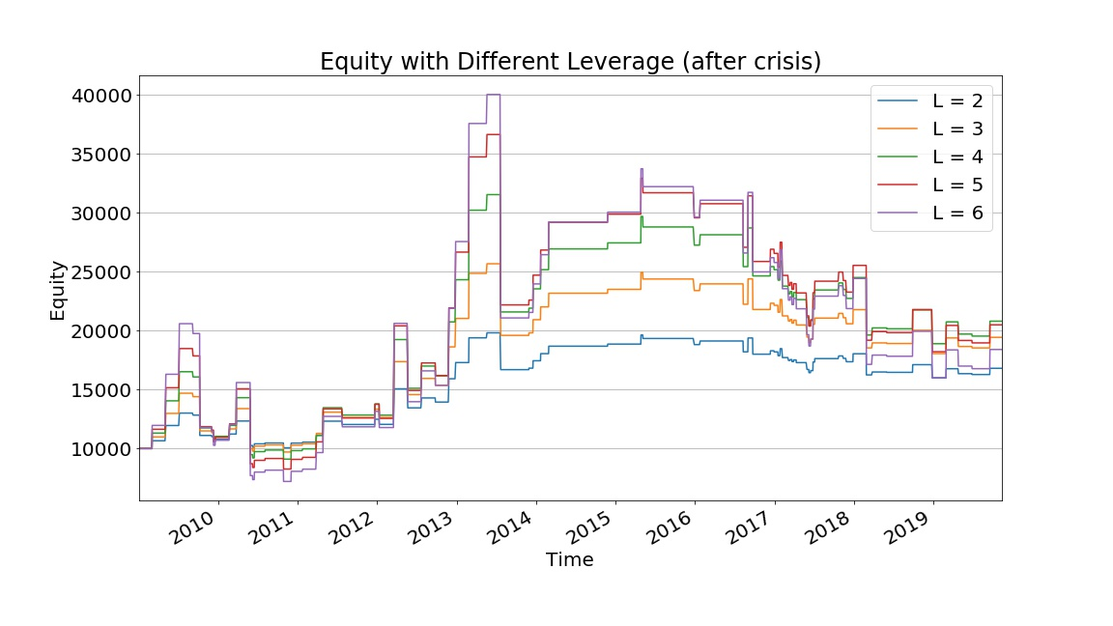
Leverage Sensitivity Analysis

Slide 21
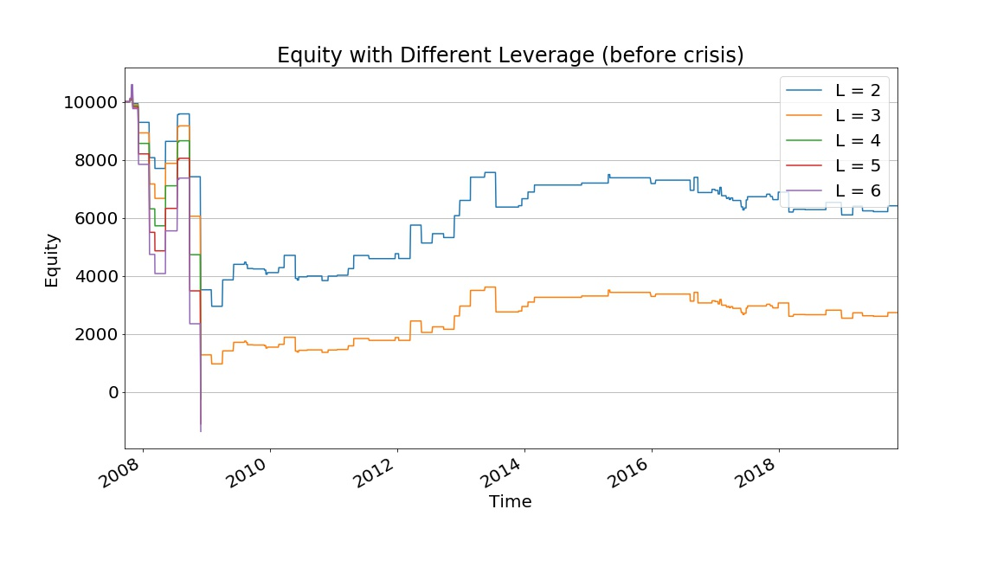
Leverage Sensitivity Analysis

Slide 22
Limitations & Improvements
Limitations:
Deviation of the Interest Rate Parity theory
Risk Control
Leverage Optimization
Improvements
Risk Neutralization on Signal
Portfolio Modification
Fluctuation Detection
Notes:
Efficient Market Hypothesis: FX forward rates is the unbiased expectation of future spot rate
We assume market is inefficient
signals should be neutralized with the volatility of fx rate.
try more currencies and optimize the portfolio

Slide 23
Conclusion
Carry Trade is profitable ---- Global Market is inefficient
Sensitive to FX rate fluctuations
Sensitive to leverage
Financial crises could have a big impact on strategy
Take a look at market information, don’t blindly trust algorithm
Keep close watch for regulatory or policy changes
Aspire to remain flat during periods of high volatility

Slide 24
References
Kent Daniel, Robert J. Hodrick, and Zhongjin Lu (2016) The Carry Trade: Risks and Drawdowns https://www0.gsb.columbia.edu/faculty/rhodrick/papers/DHL_02292016.pdf
Jeffrey Frankel Everything You Always Wanted To Know About The Carry Trade https://sites.hks.harvard.edu/fs/jfrankel/CarryTradeMilkenInReview.pdf
Lukas Menkhoff, Lucio Sarno, Maik Schmeling, Andreas Schrimpf (2011) The Risk in Carry Trade https://voxeu.org/article/risk-carry-trades
Allan M. Malz, Columbia University Lecture notes on risk management, public policy, and the financial system: Leverage Risk
Dr. David DeRosa (2010), Options on Foreign Exchange Interest Parity and Forward, Foreign Exchange

Slide 25
QUESTIONS?

Slide 26

Brief History of Foreign Exchange Market
The Gold Standard and Bretton Woods Agreement (1944)
Central Banks fix their currencies to a reserve currency (USD), which in turn is fixed to gold
The dollar was pegged to gold at $35/oz
After the dollar crisis (1973), President Nixon floated the dollar against all major currencies
Currency crisis struck emerging market nations in the 1990s
All were associated to fixed exchange rate regimes with the dollar
Examples: Mexico(1994), Russia(1998), Argentina(1998)
Players in Foreign Exchange
London, New York and Tokyo dominate the market
Customers of Forex market include: pension and mutual funds, hedge funds, private investors
Central Banks need to do “Housekeeping” trading

Slide 27

The Forex Trading Week
It begins in Austral-Asian time zone
Sydney, Tokyo, Hong Kong, Singapore
Then London and the Euro zone
London, Paris, Frankfurt
Then North American zone
New York, Chicago, Toronto
The Foreign Exchange day closes at 5PM New York time. By that time, the Australian market already opened ⇒ 24 hours market

Slide 28
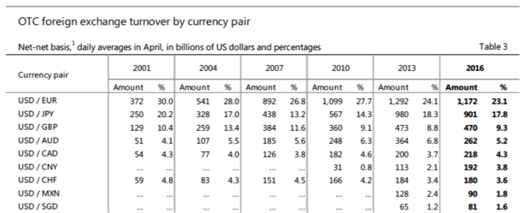
Important Currency Pairs
The US dollar was on one-side of 88% of all Forex trading in 2016

Slide 29
Market Conventions
American Convention
Currencies are quoted in dollars
Example: Sterling quoted at 1.4500 means 1 Sterling pound costs $1.4500
EUR, GBP, AUD and NZD are quoted American
European Convention
Currencies quoted in units of other currency
Example: Yen quoted at 122.00 means it take 122.00 Yen to buy $1.00
USD/JPY and USD/CHR are quoted European
Each currency pair is quoted to a standard number of decimals (pips)
USD/JPY is quoted to two decimal digits (ex: 122.00)
EUR/USD is quoted to four decimal digits (ex: 0.9210)
A pip is the smallest unit of quotation
Example: if USD/JPY moves from 122.00 to 122.05, it rose by 5 pips

